Slide 1

USA local e-commerce store DATA

Slide 2

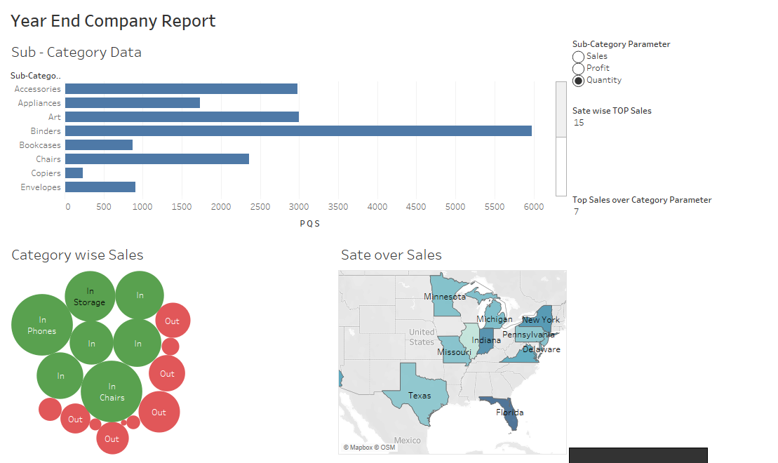

Slide 3
Here in this Dashboard, I have taken USA local e-commerce data where I have analyzed-
Sales over Category
Sales over States &
Sub- Category Data
Sales over Category – Here I have used Bubble cart & also created Parameter, IN/OUT sets to fetch Top Sales.
Sales over States – Here I have used geographical graph to show top Sales with the help of creating parameter.
Sub- Category Data – This includes (Profit, Sales Quantity) of Sub- Category with the help of creating parameter.

